Slide 1
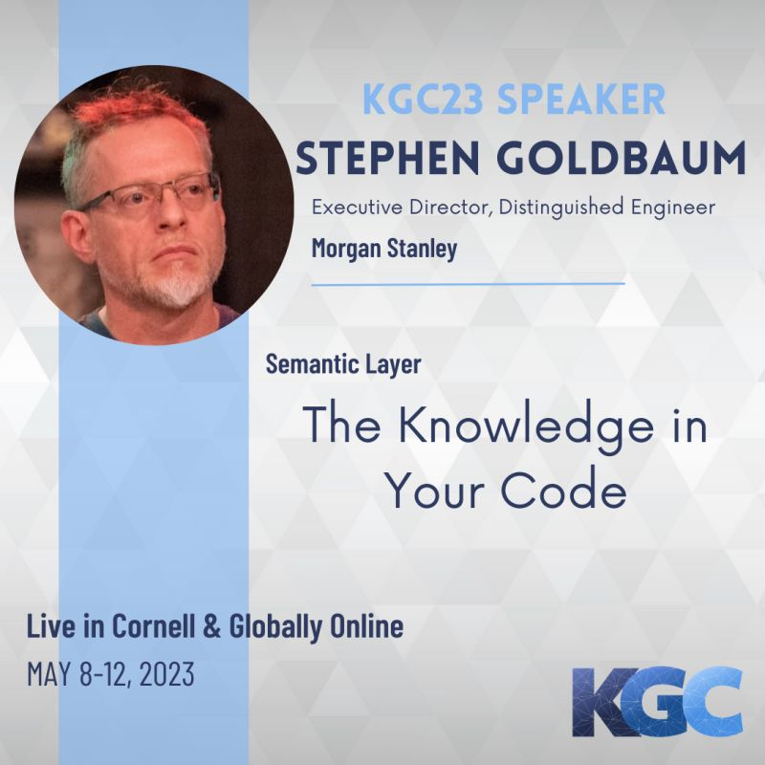



Slide 2
Goal
Make source code a participant in the knowledge ecosystem

Slide 3
Why
In Finance
Regulatory and audit requirements
Firm-wide lineage tracking
Firm-wide knowledge graphs
Linking to external ontologies
Regulations
Answering questions
What regulations pertain to x?
What are the differences across regulations that pertain to x?
What are my trade flows?
What are my cash flows?
What are all of functions that calculate x (i.e., notionals)?
Keeping in sync
Too much information to manage with manual documentation
Automated connections

Slide 4
What
What knowledge is in source code?

Slide 5
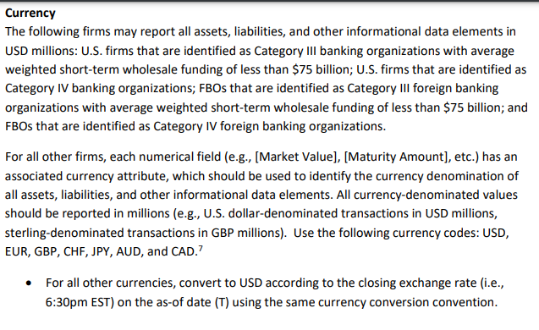
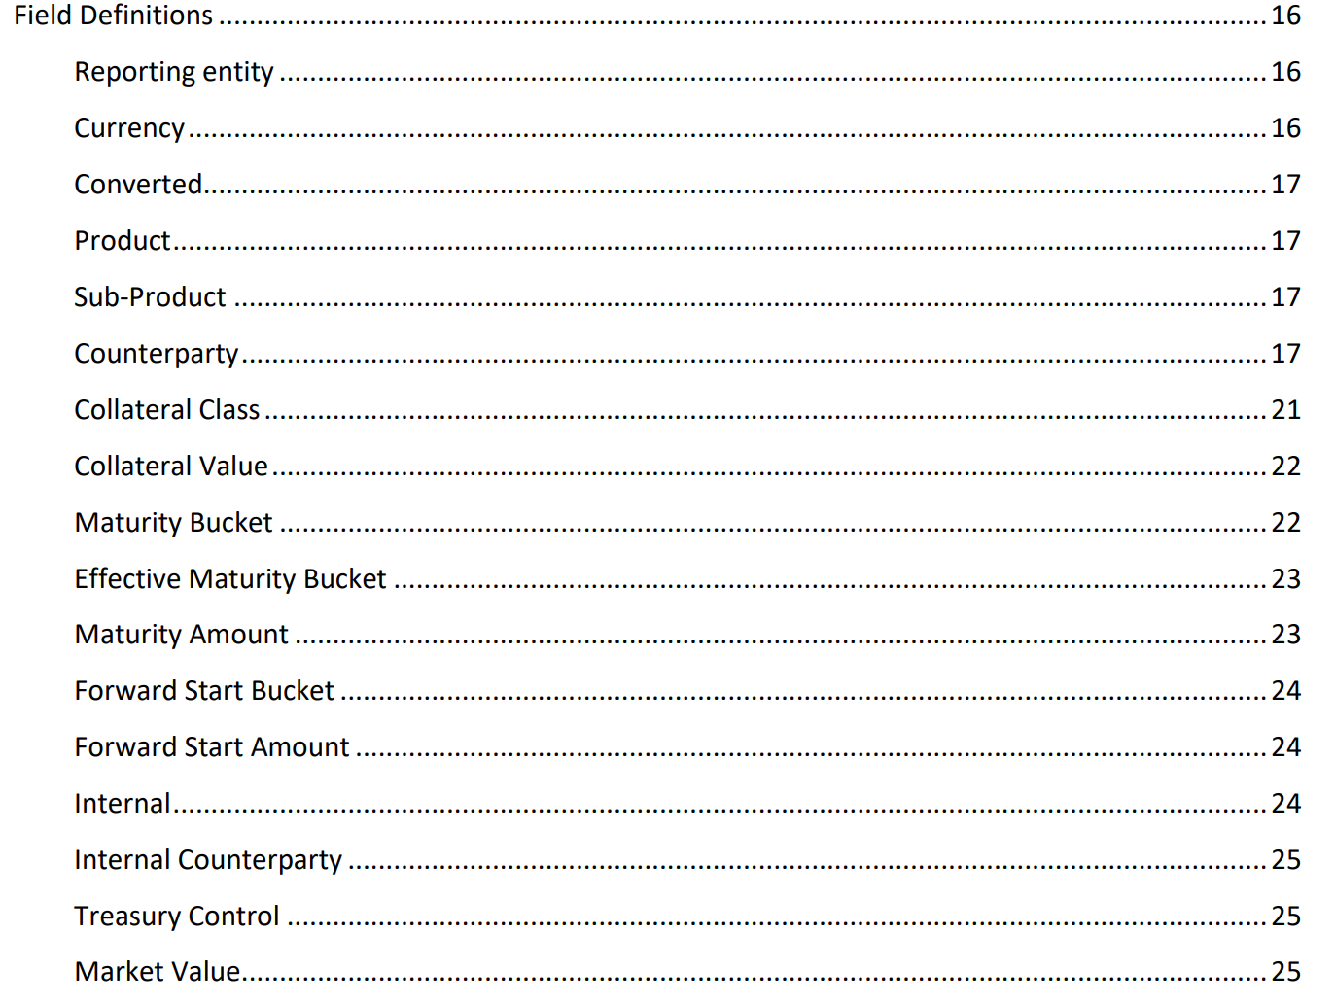
Knowledge: Glossary and Ontology

Slide 6
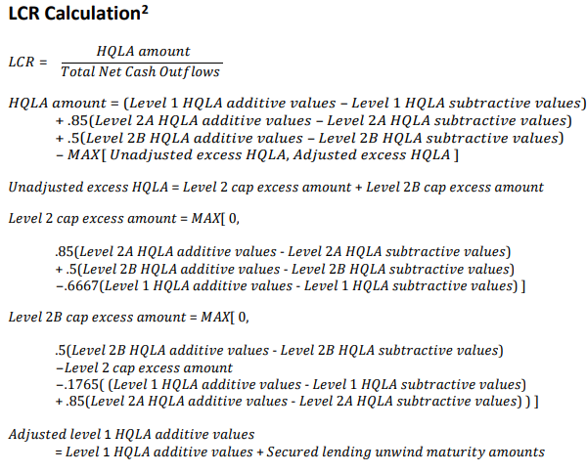
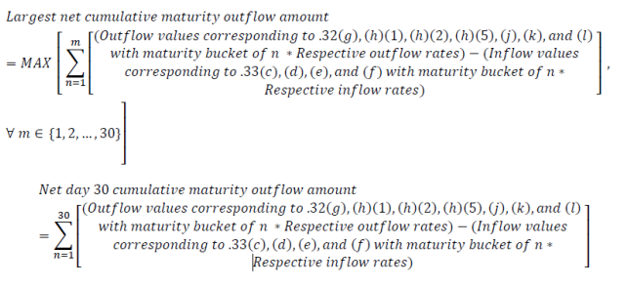
Knowledge: Business Logic & Data Lineage

Slide 7






What We Get From Code
Business Terms
Relationships
Dependencies
Business Logic
Execution

Slide 8
How
How can we use the knowledge in source code?

Slide 9
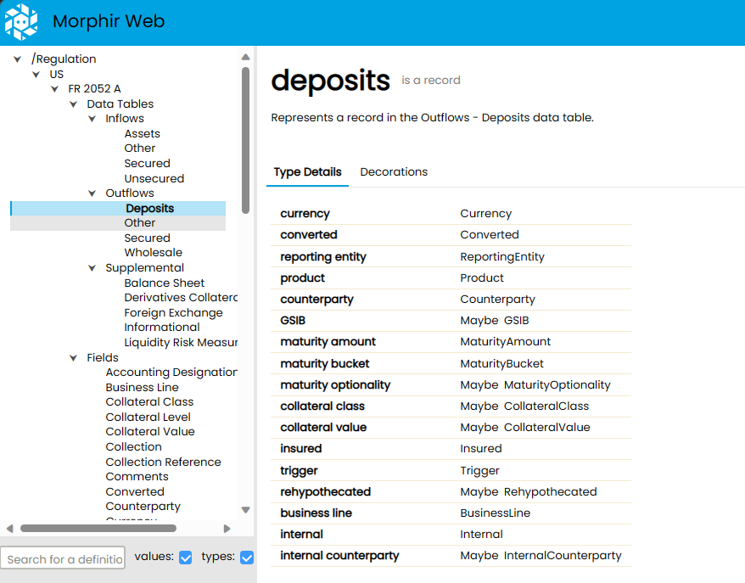
Integration with data catalog

Slide 10
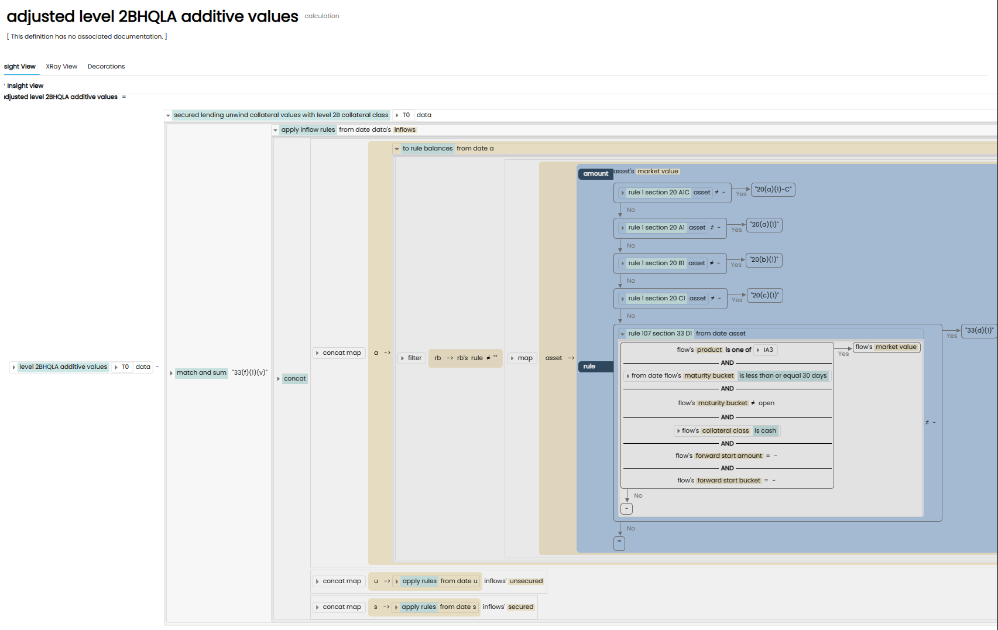
Integrate with data lineage

Slide 11
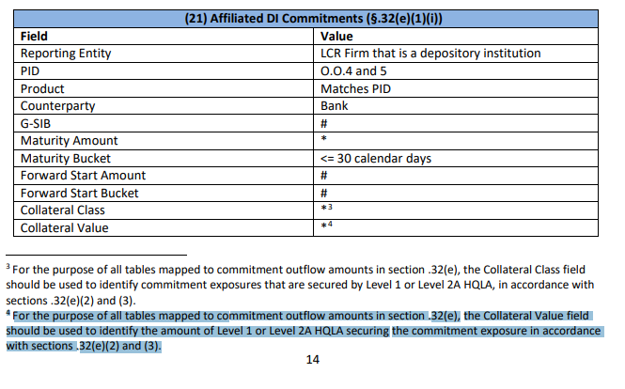
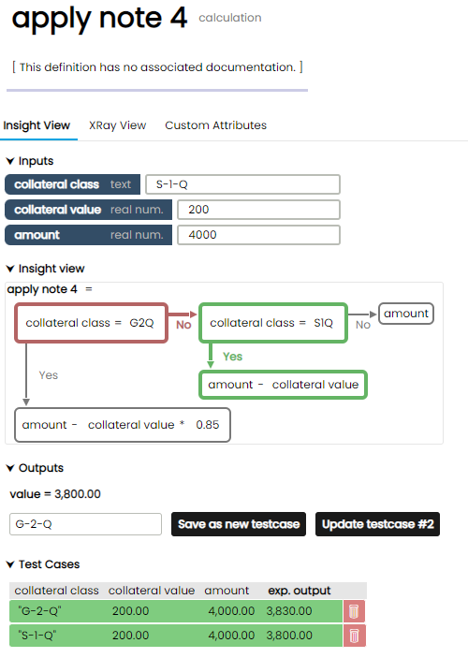
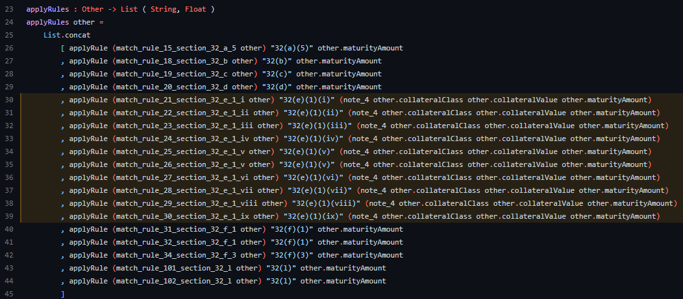
Business Logic Transparency

Slide 12
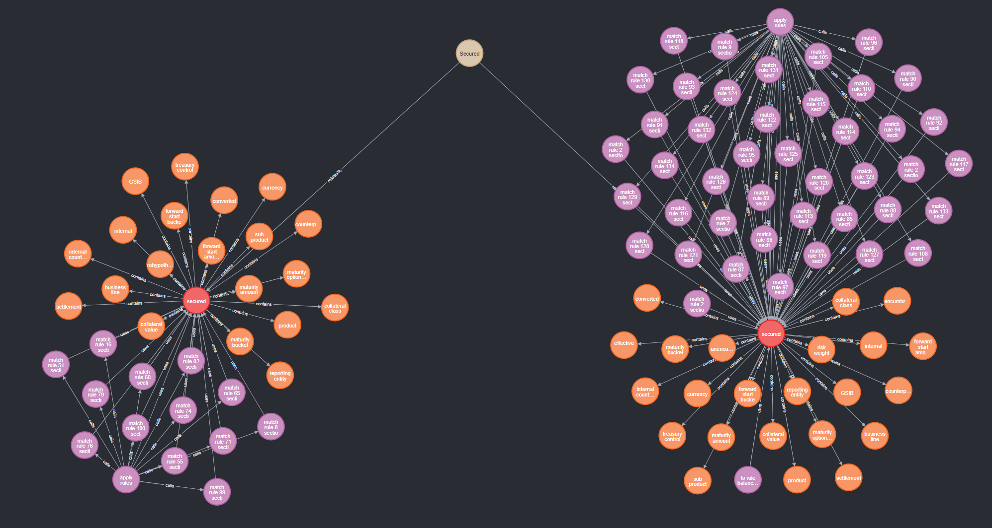
Integrate with ontologies

Slide 13
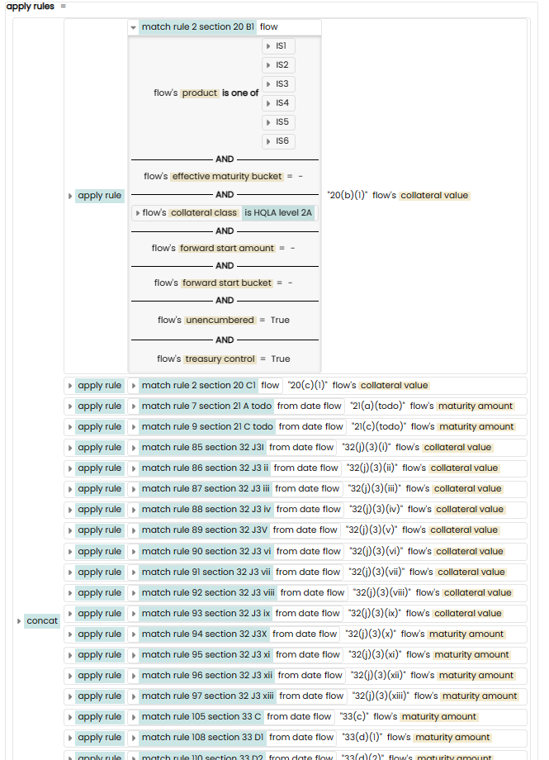
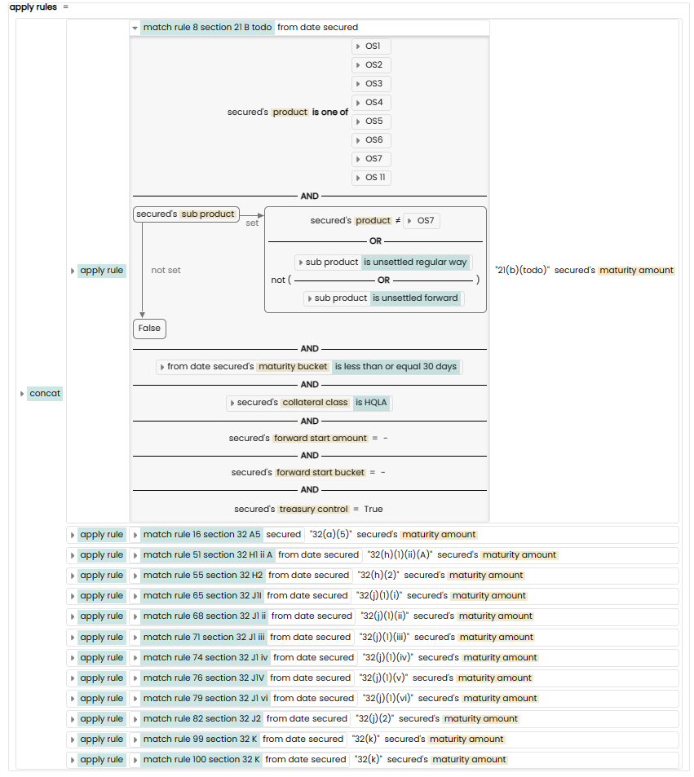
Link ontology to variance and what-if analysis

Slide 14
What We Get From Code
Business Terms
Relationships
Dependencies
Business Logic
Catalog
ontology
Execution
lineage
transparency

Slide 15
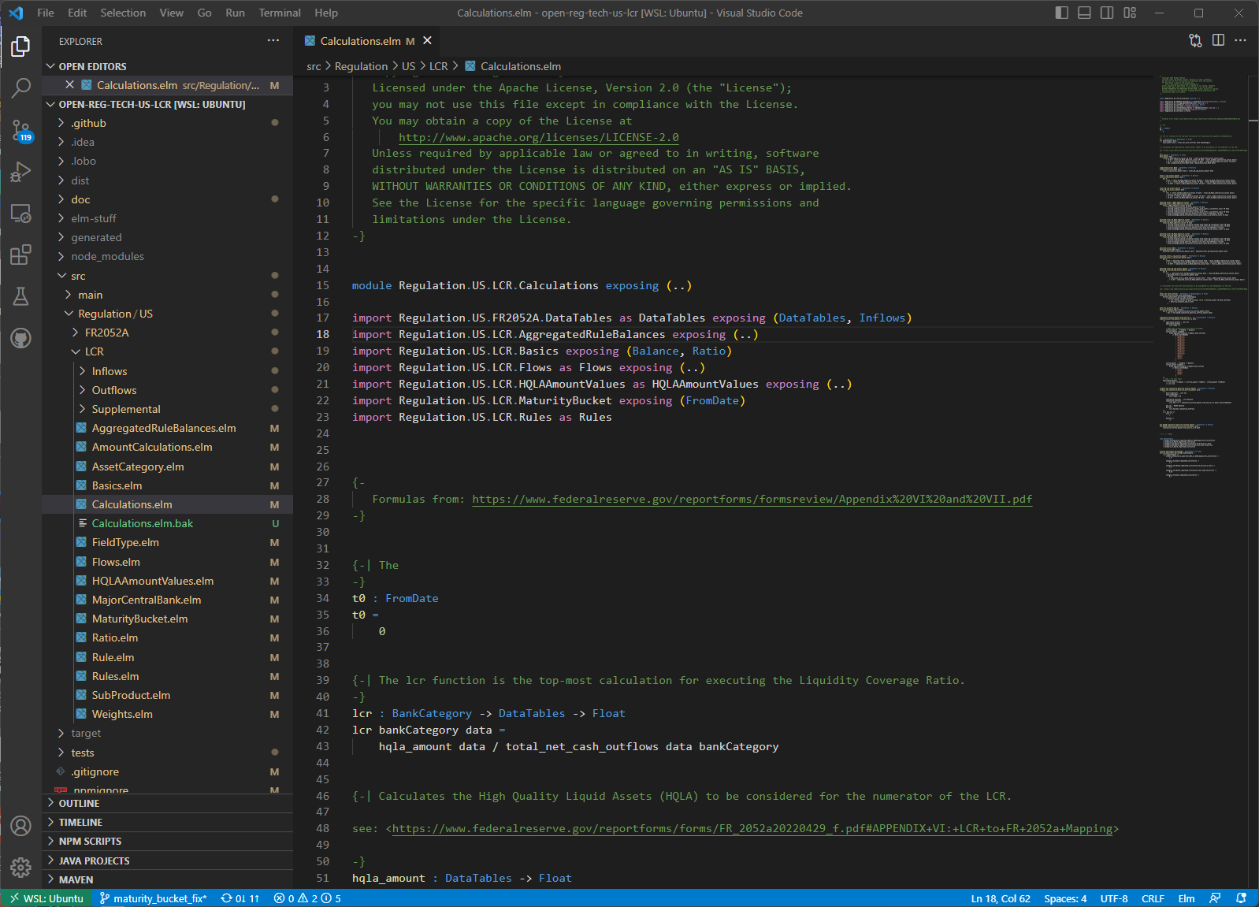
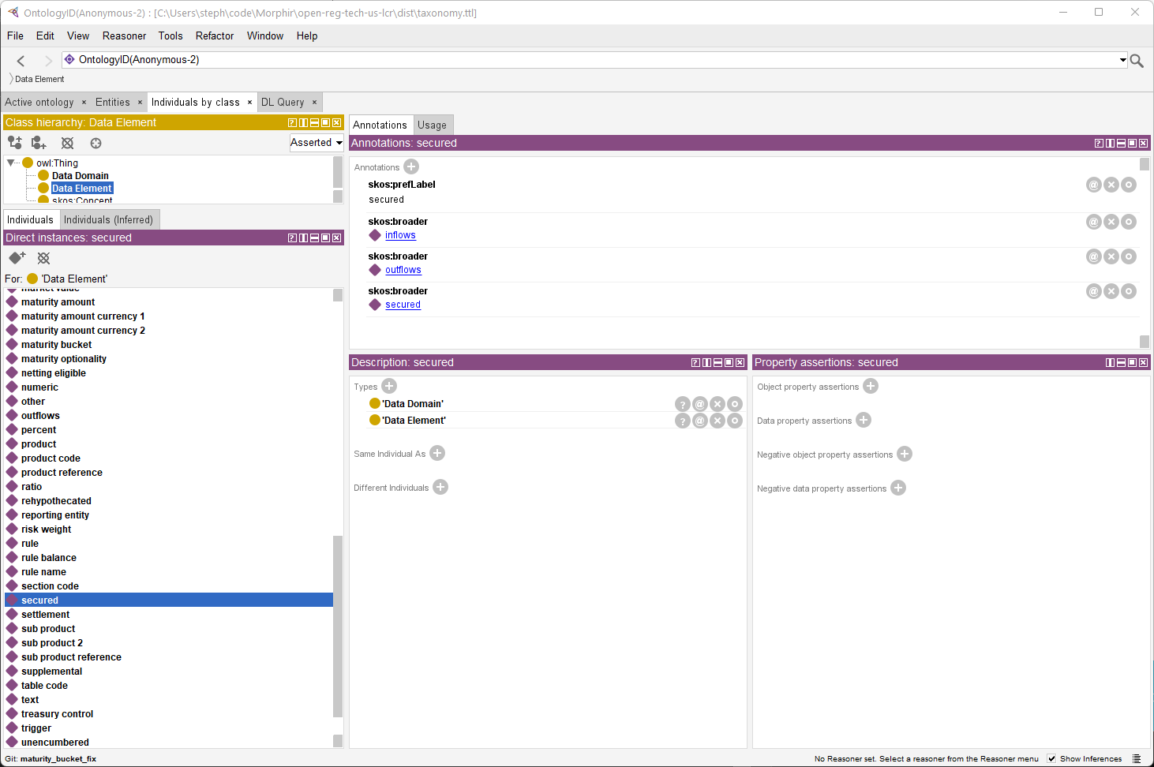
Future work: Integrate into the IDE
Integrated IDE + Semantic

Slide 16
http://morphir.finos.org

